Slide 1


PROJECT TITLE
PLANT LEAF DISEASE DETECTION
Presented by
Batch No:4
M.Krishna Teja - 20eg104236
Ch.Nikhil - 20eg104213
B.Rahul - 20eg104204
Under the guidance of
Dr.G.Renuka
Assistant Professor
Anurag University

Slide 2


abstract
plant diseases significantly threaten crop yield and national food security. Early and accurate disease detection is crucial for effective disease management. This project investigates a novel approach utilizing a Convolutional Neural Network (CNN) for automated disease detection in tomato plants. The system leverages image processing techniques to analyze digital images of tomato plants, aiming to classify them as healthy or diseased. This research explores the potential of CNNs to revolutionize disease detection in tomato crops, empowering farmers with a rapid and reliable tool to identify and combat diseases. By enabling timely interventions, this project contributes to improved crop health, increased agricultural productivity, and enhanced food security in India.

Slide 3
INTRODUCTION
India's agricultural sector is vital, but a persistent threat exists – plant diseases. These devastate crops, impacting tomato production and food security. Early and accurate detection is crucial for effective management.
Traditionally, this relies on visual inspection by experts, but it's time-consuming and prone to error.
This project explores a cutting-edge solution: a Convolutional Neural Network (CNN) system for automatic disease detection in tomato plants using image analysis. Our goal is to empower farmers with a rapid and reliable tool to identify and combat diseases, ultimately safeguarding crop yields and contributing to India's agricultural resilience.

Slide 4
EXISTING METHOD
Machine learning (ML) excels in plant disease detection, but challenges remain:
Limited Generalization: Models struggle with variations in lighting, weather, and plant types. We need more adaptable models.
Lack of Interpretability: We can't understand how ML models reach conclusions, hindering trust from farmers. Explainable AI is crucial.
Scalability and Efficiency: Training complex models requires high computing power, limiting use in resource-constrained settings. Efficient algorithms are needed.
Standardization: Inconsistent evaluation metrics make it hard to compare research. We need standard datasets and benchmarks.
Open Access: Sharing datasets and models fosters collaboration and advancements.
These challenges require collaboration across disciplines to create effective tools for disease management and crop protection.

Slide 5
OBJECTIVEs
This project tackles plant leaf disease detection using machine learning. We'll:
Build a labelled image dataset of various diseases across crops.
Develop CNN models to classify these diseases from the images.
Rigorously evaluate and fine-tune the models for accuracy.
Integrate the models into a user-friendly application.
Validate the system in real-world agricultural settings.
This empowers farmers and researchers for early disease detection and improved crop health.

Slide 6
PROPOSED METHOD
This method uses CNNs to detect diseases in plant leaves from images:
Image Acquisition: Capture a digital image of the leaf.
Preprocessing: Enhance image quality (resize, adjust color, reduce noise).
Feature Extraction: Extract key characteristics like color, texture, and shapes.
Training: Train a CNN model using a database of healthy and diseased leaf images.
Classification: Use the trained model to classify new images as healthy or diseased.
(Optional) Defect Region Classification: Identify specific areas of disease on the leaf.
This approach automates disease detection and aids in early disease management for improved crop health.

Slide 7
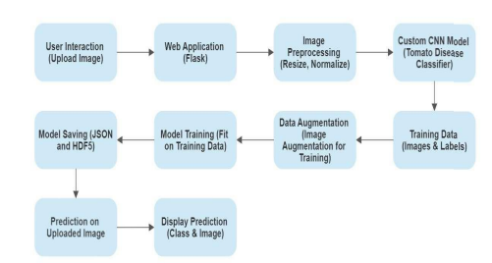
Block diagram
Fig.2: Block diagram representing components used in the project
Fig. 1: Block Diagram for Plant Leaf Disease Detection

Slide 8
COMPONENT REQIREMENTS
Hardware
RAM: 4GB RAM is a minimum, but 8GB or more is recommended for smoother operation, especially during training.
Storage: 160GB hard drive might suffice for basic setups, but an SSD (Solid State Drive) and more storage will be helpful for larger datasets and libraries.
Monitor: Standard monitor is sufficient.
Software
Python: A high-level programming language used for machine learning. It's free, open-source, and beginner-friendly.
Machine Learning Libraries: Libraries like TensorFlow, Keras, and scikit-learn provide tools for building and training machine learning models.
Jupyter Notebook: An interactive environment for developing and documenting your machine learning code.
Google Colab: A cloud-based platform offering free access to powerful hardware resources for running computationally intensive tasks like training deep learning models.

Slide 9
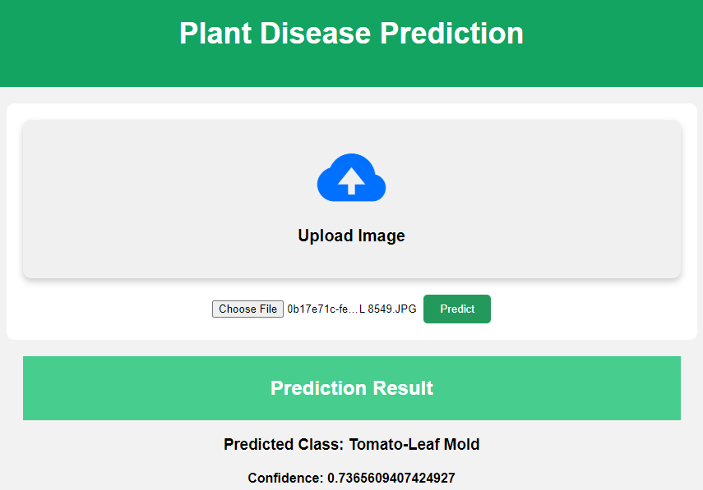
RESULTS
Fig :Output of Prediction Result

Slide 10
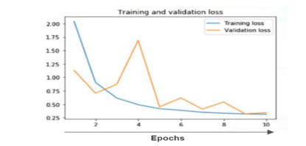
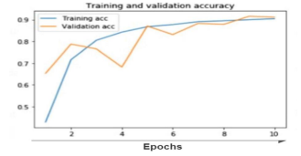
RESULTS
Fig : Training and Validation Loss
Fig :Training and Validation Accuracy

Slide 11
CONCLUSION
The project successfully developed a plant leaf disease detection system using CNNs, achieving high accuracy (92.00%) and demonstrating its potential to revolutionize crop management. This system benefits agriculture by:
Enabling early disease detection: Farmers can take timely actions to minimize crop losses.
Facilitating data-driven decisions: Valuable insights on disease prevalence aid in resource allocation.
In conclusion, this project with its accurate disease detection system and user-friendly application paves the way for a future where machine learning empowers farmers and contributes significantly to food security and sustainable agriculture.

Slide 12
references
1.P Krithika, S Veni”Leaf disease detection on cucumber leaves using multiclass support vector machine” IEEE International Conference on Wireless Communications, Signal Processing and Networking (2017), pp. 1276-1281
2.R Prakash, G P Saraswathy, G Ramalakshmi ”Detection of leaf diseases and classification using digital image processing” IEEE International Conference on Innovations in Information, Embedded and Communication Systems (2017), pp. 1-4
3. B Mishra, S Nema, M Lambert, S Nema”Recent technologies of leaf disease detection using image processing approach-review” IEEE International Conference on Innovations in Information, Embedded and Communication Systems (2017), pp. 1-5
4. C. Puttamadappa, B.D. Parameshachari”Demand side management of small scale loads in a smart grid using glow-worm swarm optimization technique”Microprocessors Microsyst., 71 (2019), Article 102886

Slide 13
Thank you

